Slide 1
Introduction to Crypto
1
Blockchain Innovation Continued
Kathryn Zhao
Denis Imaev

Slide 2
Introduction to Crypto
Recap: Trust-less is a feature
You can trust
But do not have to
… and you can choose who to trust
Trusting = Relying on. Relying on an entity to work correctly is a technical weakness That entity can fail for various reasons
Trust is a liability for all parties

Slide 3
Introduction to Crypto
From Trust to Proof
Various decentralized consensus protocols
Proof of Authority
Proof of Resources
Proof of History
Proof of … Trust
TRUST → PROOF

Slide 4
Introduction to Crypto
Back to decentralized consensus
The general practice of decentralized consensus is to make it impractical (infeasible) for any single malicious actor to have enough resources to attack the network.
In a true decentralized network, you cannot force them – but you can incentivize them!

Slide 5
Introduction to Crypto
Why “work”?
If you must work for something, you value it more.
Work done is an incentive to protect the result.
You will work for something that is likely to be accepted by others
… And will not work for something that is likely to be discarded. Incentive to work towards the common goal

Slide 6
Introduction to Crypto
Proof-of-Stake
Doing “work” for seemingly nothing got some bad rap: “wasted” energy.
“work” (expenditure of resources) → “stake” : committing something else instead of physical resources.
Proof-of-Stake: blocks added by committing money
Another kind of investment?

Slide 7

Introduction to Crypto
Shared State
Transactions change the state of the world
Consensus: getting everyone agree on transactions and their order
Consensus: mechanism to share state globally

Slide 8
Introduction to Crypto
Blockchain: global shared state
Blockchain → global distributed state machine

Slide 9
Introduction to Crypto
Distributed Computer
But … a computer is a state machine as well!
… plus programs that it executes to change the state
If we have a way to “program” transactions …
… blockchain will take care of propagating them everywhere

Slide 10

Introduction to Crypto
Generalize: Transaction → Smart Contracts
Ethereum key innovation: expand blockchain state to be generic and add programs that manipulate it

Slide 11
Introduction to Crypto
Smart Contracts
Programs that operate on the distributed state machine of blockchain, causing state transitions
Bitcoin also has “smart contracts” (not so smart)
Bitcoin state and contracts are of the simplest kind: funds and scripts that move them.
Bitcoin scripts are kept simple to maximize security.

Slide 12
Introduction to Crypto
Smart Contracts: who executes them?
Smart contracts alter the state of blockchain.
Network nodes must maintain the accurate state.
Each network node executes smart contracts, so they know the next state

Slide 13
Introduction to Crypto
Smart Contracts: where do they live?
Contract code resides on the blockchain: it has an address.
Created by a special transaction
A transaction sent to the contract triggers its execution (and serves as the input)

Slide 14
Introduction to Crypto
Smart Contracts
Network nodes run the contract, change the state and produce new transactions as the output
Nodes are compensated for running the contract through fees in the same way they are compensated for validating and adding transactions to the blockchain.
Computation has explicit cost. More computation is more expensive.

Slide 15
Introduction to Crypto
Blockchain summary: a global distributed computer
Public blockchain: a global distributed computer
Secured by trustless consensus
State and programs replicated and shared across the network
Anyone can join and use the network / computer
Anyone can program for the network
Anyone can support the network and get rewarded

Slide 16
Introduction to Crypto
Smart Contracts: new computing platform
Software that lives on blockchain and manipulates blockchain data
New computing platform
New platform causes an emergence of a new industry
First computers, PC, Smart Phones…
The same will happen with blockchain

Slide 17
Introduction to Crypto
Blockchain software examples today
Tokenization
Contracts that manage ownership records
Distributed resources (storage, computing power
Contracts manage resources and calculate “rent”
Decentralized Autonomous Organization (DAO)
No “killer app” yet (?)
Or is there… ?

Slide 18
Introduction to Crypto
Network participants: the identity
Every participant in the network has a unique Identity
Identity has the public part visible to all: the address (public key)
A transaction has a sender and a recipient, identified by their addresses
Identity has the private part, known to the owner only (private key)

Slide 19
Introduction to Crypto
Network participants: the identity
The key is YOU
Loss of the key is a loss of the identity
Not your key – not your crypto

Slide 20
Introduction to Crypto
The origins of “crypto”: identities
Cryptography:
a way to prove the identity without revealing it (using the private key)
A way to validate this proof, i.e. verify the identity
Validation is easy, quick and cheap
This is at the heart of building reliable networks, and this part is not blockchain specific.

Slide 21
Introduction to Crypto
Cryptography: data representation and linking
Means to create data representation: hashes.
Small piece of data that “represents” much larger data.
The original data cannot be recovered from the hash. Any change in the original changes the hash.
Way to link sequences of data (transactions), blocks etc. by mixing bits of data together such that the link can be verified. Any attempt to change the data will break the link.

Slide 22
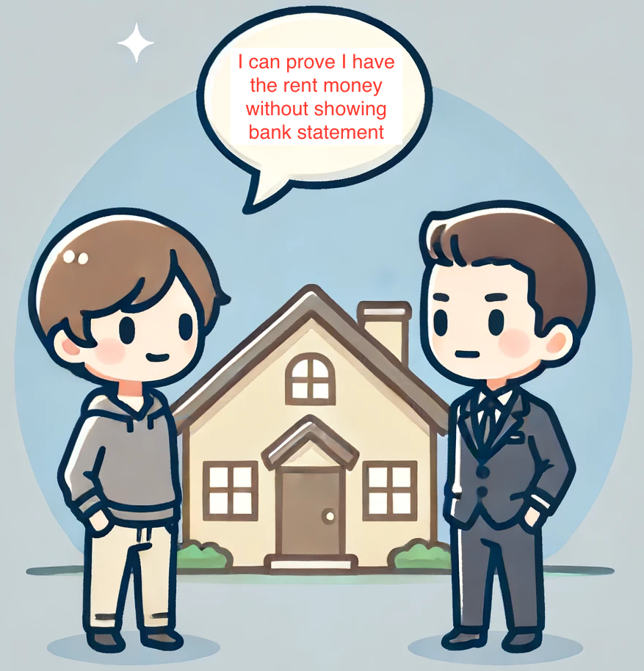
Introduction to Crypto
Cryptography: data proofs
“Proofs”: small piece of data that proves complex states and transitions
Allows making statements about something without giving access to the data itself.

Slide 23
Introduction to Crypto
Cryptography: data compression
Blockchain gets larger …
Cryptographic proofs may offer the way to cope!
Way to compress data (history).
Create the proof that the old data is correct, leave the proof, and delete the data itself!
Altered history (fork) will produce a different proof

Slide 24
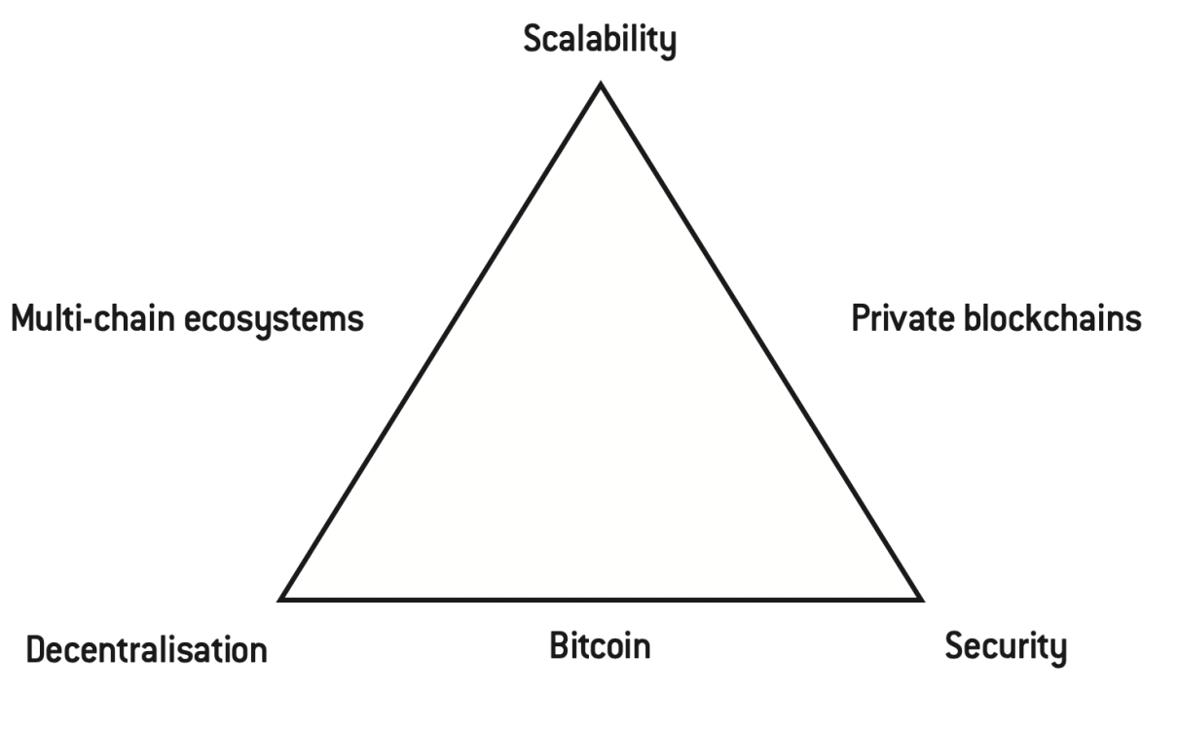
Introduction to Crypto
Blockchain trilemma

Slide 25
Introduction to Crypto
We want security, scalability, decentralization.
We can only have two.
Which one is easier to do without?
Which ones are more important (valuable) than others?

